Slide 1
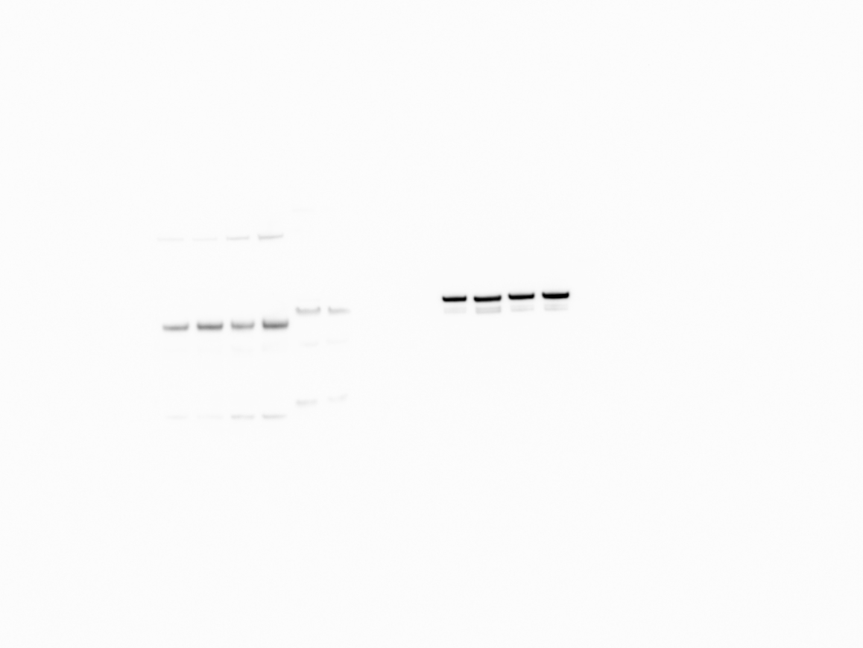
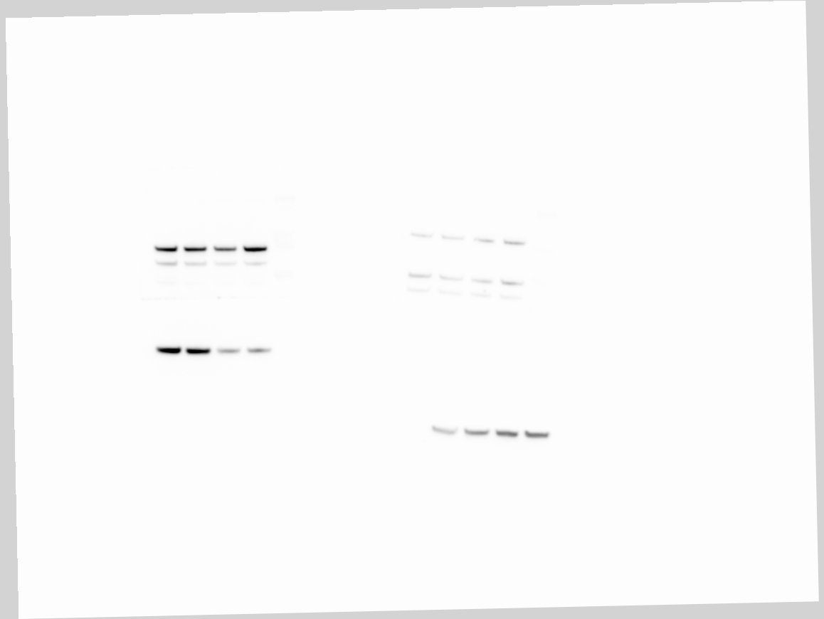
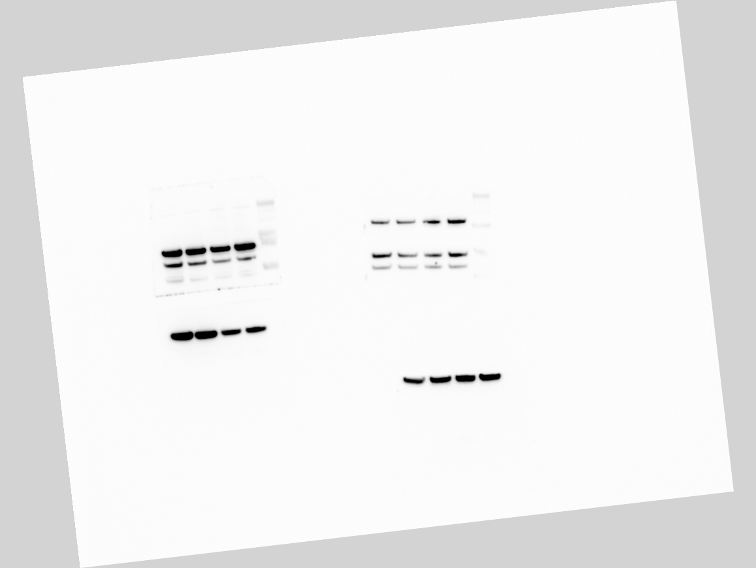
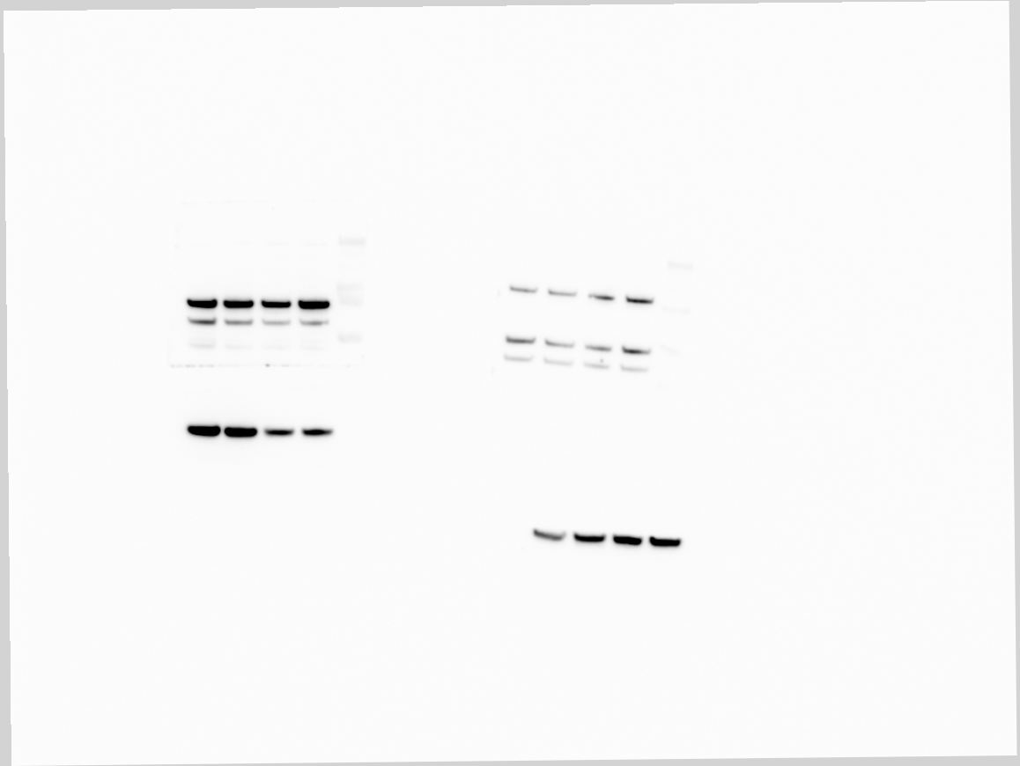
c-myc
NFƘb-p65
P-NFƘb-p65
Bcl-2
PGC1a
Actin
HSP90
AGI
-
+
-
+
56-11
M14R132

